Slide 1

CLASSIFICATION OF SIGNIFICANT WATER RESOURCES AND DETERMINATION OF RESOURCE QUALITY OBJECTIVES FOR WATER RESOURCES IN THE USUTU TO MHLATHUZE CATCHMENTS (WP11387)
Study Inception Meeting
11 February 2022

Slide 2
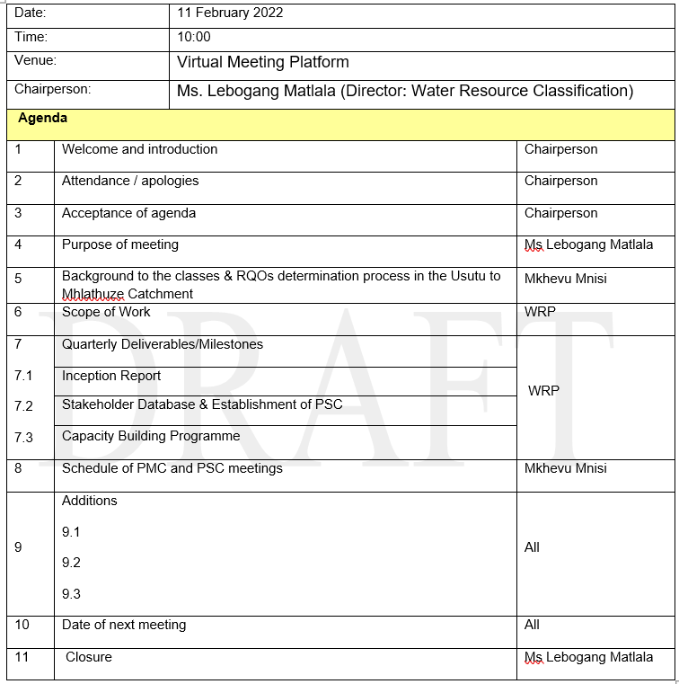
Agenda

Slide 3
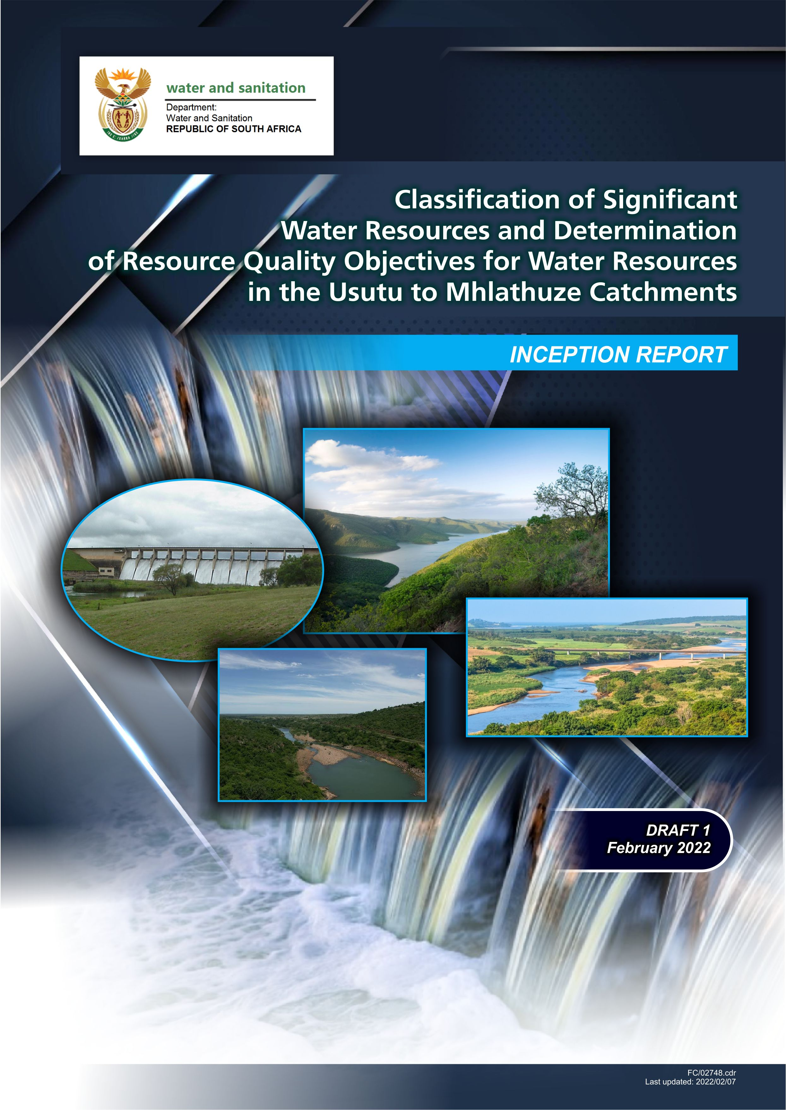

6&7: Presentation of Inception Report

Slide 4
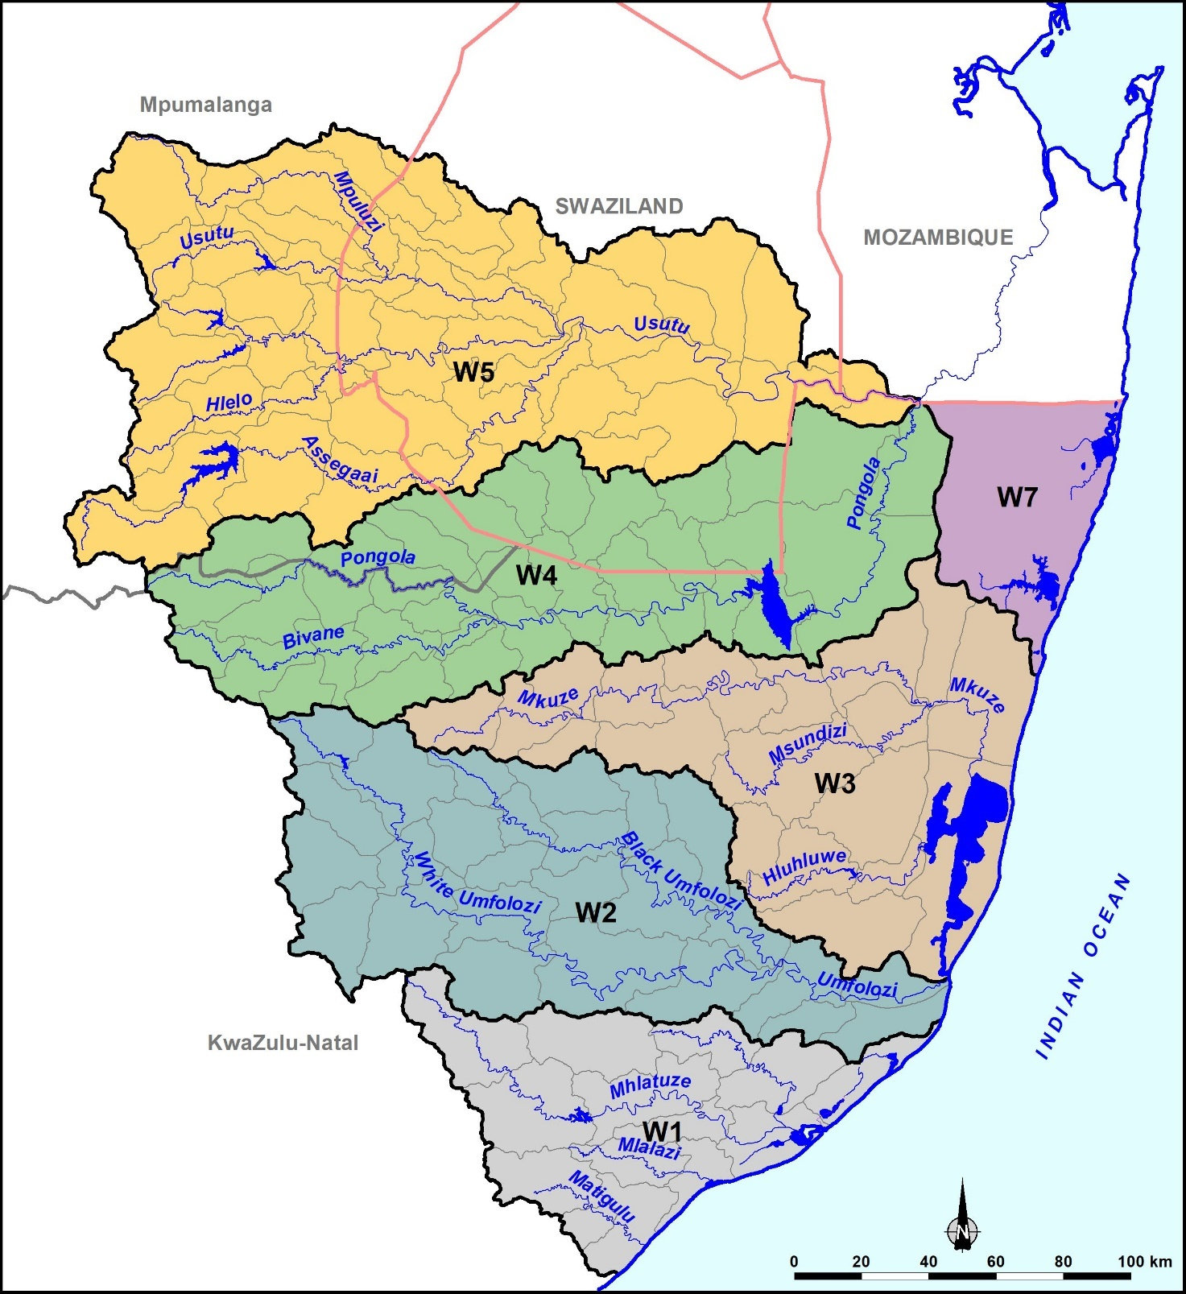
Study Area

Slide 5
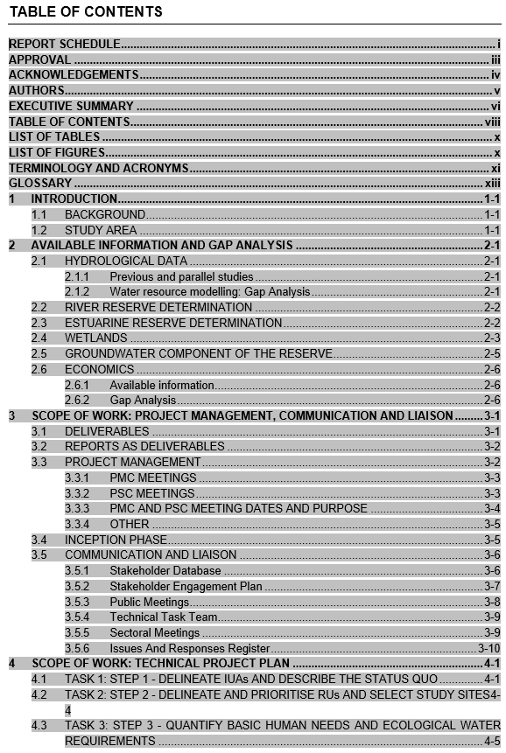
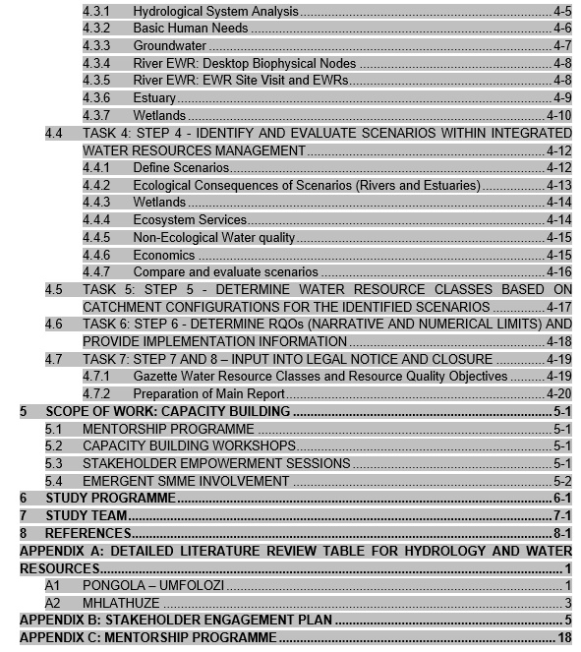
Table of Contents

Slide 6
Technical Tasks:
Approach
(Chap 4 of Inception Report)
(D Louw)

Slide 7
TECHNICAL TASKS: PROJECT PLAN
Project plan consists of a series of steps according to the approved integrated steps for Classification, Reserve and RQOs.
The basis of these steps is to build a picture starting with study area description and ending with a description of the future state of the study area and its resources and how to achieve it.
Reserve tells you what is necessary for a certain ecological state as well as the Basic Human Needs Required.
Classification provides the balance between use and protection leading to a defined future state of the environment.
RQOs provides the means to measure through monitoring whether one has achieved the balance (state) defined during classification.

Slide 8
STEP 1 AND 2: Status quo, importance and priorities, delineation into units
How do we break the catchment up into manageable units?
What is the status of these units in terms of water resources, ecology, economy, social, water quality etc?
How important (from various perspectives) are the units?
How do we prioritise these units to know where to do detailed work – given the large study area?

Slide 9
STEP 1 AND 2
Large study area (Primary Catchment W) consisting of six secondaries (W1, W2, W3, W4, W5, W7).
Study area is delineated into Subquaternary Reaches (SQs). Delineation available. PES for each (reviewed during this study) and EIS is available for each SQ.
MANY SQs – therefore group together into Resource Units (RUs). Resource Units are the scale at which all evaluations are undertaken.
Group RUs into Integrated Units of Analysis (IUA) – the scale at which Classification is undertaken. Each IUA consists therefore of RUs and this represents an IUA and its Catchment Configuration.
All information captured in a working spreadsheet which forms the basis of all classification results.

Slide 10
STEP 3: BHN and EWR
What are the discharge and quality required to achieve a certain ecological state in rivers, wetlands, and estuaries?
How many persons do not have access to piped water or water from boreholes? Calculate a range of basic human needs allocations.
EWRs:
Reserve study undertaken (2014) in preparation for Classification.
Results (8 EWR sites) will be used and adjustments made where required – recalculate EWRs using the accepted DWS hydrology. Ecostatus models will be run or reviewed pending availability.
Desktop model will be used to provide desktop estimates for RUs not represented by EWRs.
Estuaries and wetlands will also use results from previous studies and reviewed where required.
Results provided as EWR rules – the required format

Slide 11
STEP 4 & 5: Operational scenarios, consequences, proposed Classes and TECs for the catchment configuration.
What future water resource developments or related developments are in the pipeline that could effect the status quo?
How will it effect the status quo?
How do we manage (operate) our water resources to balance use considering socio-economic and other implications and the impact on our environment?
How do we manage our current water resources to possibly reach an improvement in the environmental / ecological status in certain areas if required?
Which of these scenarios are acceptable for Classification?
What are the Target Ecological Categories associated with the accepted scenario?

Slide 12
STEP 4 & 5
Identify a range of scenarios in those systems where one has detailed EWR information available.
Test the range with stakeholders.
Model the scenarios and provide the consequences on state in terms of ecology, economy, socio-economics
Attempt to develop an optimised scenario to maximise yield and have minimal impacts on socio-economics and ecology. Also to possibly improve the states where necessary.
Present to stakeholders.
Recommend an operational scenarios considering the implication on the ecological state.
Provide the agreed Target Ecological Categories associated with the accepted operational scenario and prepare Classification documentation

Slide 13
STEP 6: RQOs
How do you determine whether you are complying to the Class and the TECs?
What do you measure to determine whether you are complying?
How do you operate/implement to determine whether you are complying.
Define (quantify and quality) the TECs for high priority RUs in terms of RQOs.
Provide a monitoring programme on how to measure.
Provide input into an implementation plan.

Slide 14
Gap Analysis
(Chap 2 of Inception Report)
(C Seago)

Slide 15
Hydrology & Water Resources
Parallel Study (Recon Strategy)
Rainfall Data
IUCMA detailed assessment
Possible Gap
MWAAS, Compulsory Licensing
Different hydrology to Reserve Study

Slide 16
River Reserve
EcoStatus Models, not mentioned in Ecostatus report of Reserve Study. Unclear if used, possibly only “DRIFT” process
Hydrology on Black Umfolozi to be updated, concerns were found with previous hydrology used for reserve determination
Mhlathuze EWRs done for Compulsory licensing, to be used without change

Slide 17
Estuary Reserve
8 of the 9 estuaries been covered in previous studies, albeit mostly at low confidence.
No EWR determination has been undertaken on the uMgobezeleni Estuary
iSiyaya (2006), Mhlathuze /Richards Bay (2000), and iNhlabane (2000) largely followed outdated methods or do not reflect current pressures on the systems. 2015 evaluation based on 2000 work
4 estuaries: EWRs will be re-assessed or alternatively, new EWRs will be determined.
5 estuaries results from previous studies will be used in terms of the PES and REC. However, any new operational scenarios, and associated ecological categories, will have to be re-evaluated.
The importance of addressing the freshwater flow requirements of the marine environment in EWR and Classification studies has been highlighted in the Framework for Operationalising Resource Directed Measures (RDM) (DWS, 2016a). However, the TOR of this study does not mention any investigations into the marine component and is thus not included in the formal project work plan or budget. Given the importance of freshwater flow from the Umfolozi (and potentially the Umlazi), it would be important to determine any riverbed dependant nearshore ecosystems in the study area. The exclusion of this work is seen as a significant gap in the study approach.

Slide 18
Wetlands
Criteria | Data available | Gaps identified
Wetland mapping | NFEPA, NWM5. | Coarse scale, often under mapping.
Wetland typing | NFEPA, NWM5. | Lack of field verification of the HGM types.
Wetland PES and Ecological Importance and Sensitivity (EIS) | NFEPA: for all mapped wetlands, PES has been inferred based on land cover. | Lack of field verification for PES, low confidence.
 | PES-EI-ES (DWS, 2014e): Two metrics rated for riparian / wetland continuity and integrity at the desktop level (Google Earth ©). | Metrics include riparian zones and frequently omit wetlands with the SQR that are not directly linked / related to the main channel, not wetland specific.
Wetland prioritisation | List of high priority wetlands with assessment criteria and detailed methodology. | Conducted in 2013, 2014, may be outdated in certain aspects.
Wetland EWR | Sibaya, Pongola floodplain including Ndumo wetlands, St Lucia (many estuaries have EWRs at different levels), Kosi (rapid) | Chrissiesmeer pans, Kosi Bay (lacks detail)
Wetland Reference State | Historical studies e.g. Chrissiesmeer, 1929 and 1943 studies. | No PES, no EWR.

Slide 19
Management & Meetings
(Chap 3.3 of Inception Report)
(C Seago)

Slide 20
Proposed Month | Meeting Ref no. | Focus
26 Jan 2022 | Kick-off meeting | Kick-off meeting
11 Feb 2022 | Inception meeting | Present Inception Report
3 May 2022 | PMC meeting 1 | Dry-run for Public meeting 1
4-5 May 2022 | Public meeting 1 | Introduce Study, present inception report
April 2022 | PMC meeting 2 | Present progress and dry-run planning for PSC meeting 1 (delineation and status quo)
May 2022 | PSC meeting 1 | Steps 1 and 2: Status Quo, Delineation of IUAs
Nov 2022 | PMC meeting 3 | Present progress and dry-run planning for PSC 2 (Hydrology, River EWRs, BHN). Table and discuss Scenario document (identify scenarios) and dry-run planning for PSC 3.
Dec 2022 | PSC meeting 2: Day 1 | Stakeholder empowerment session Step 3: EWRs, BHN, groundwater, and wetlands
Dec 2022 | PSC meeting 3: Day 2 | Step 4: Input to scenarios
April 2023 | PMC meeting 4 | Table and discuss Water Resources Classification discussion document and dry-run planning for PSC 4 (consequences and draft classes)
April 2023 | PSC meeting 4 | Step 5: Consequences and draft classes
Aug 2023 | PMC meeting 5 | Present progress and dry-run planning for PSC 5 (RQOs)
Sept 2023 | PSC meeting 5 | Step 7: Classes and RQOs
Jan 2024 | PMC meeting 6 | Dry-run for Public Meeting 2
Feb 2024 | Public meeting 1 | Present Study Results
May 2024 | PMC meeting 7 | Wrap up of Study

Slide 21
Stakeholder Database & Engagement
Plan
(Appendix B of Inception Report)
(A Lotter)

Slide 22
Stakeholder Database and Establishment of PSC
Draft database ready for DWS review and additions
  Purpose of database
  CMFs, DWS officials, Irrigation Boards, WUAs
  POPI Act requirements
Public meetings
  Purpose (announcement of study, establishment of PSC)
  Dates (3/05 – dry-run and 4 and 5 May),venues (Richards Bay and Pongola) and format of meetings (hybrid, interpretation)
  Documents (Invite, agenda, BID, PSC nomination form)
  Establishment of PSC (nominations)
Stakeholder Engagement Plan (SEP)

Slide 23
POPI Act
As per the requirement of the Protection of Personal Information Act (POPI), Act No.14 of 2013 you are herewith notified that you may exercise your right to leave the Interested and Affected Party (IAP) List. Should you elect to remain as part of the IAP List for the study, it will be accepted that you have consented to being a part of the list and that your personal information will be noticeable to employees of DWS and their Professional Services Provide team engaged with the public participation process. All such employees agree not to make use of such personal information for whatsoever reason, without obtaining the consent of the relevant person(s). As such, by participating in this process, you consent to the use of your contact information and comments for the purposes of the study as per the regulations.

Slide 24
Capacity Building
(Appendix C of Inception Report)
(P Scherman)

Slide 25
CAPACITY BUILDING
Three aspects:
  Capacity building workshops:
    An overview of Classification, Reserve and RQOs as RDM tools in IWRM; proposed for May 2022.
    Operational scenarios – selection, modelling and evaluation – and Classes; proposed for August 2023.
    RQOs and gazetting; proposed for December 2023.
  Mentorship programme: designed for Mr Mnisi (focus on estuaries) and Ms Makanda (focus on wetlands).
  Stakeholder capacitation sessions: important sessions to develop understanding of terminology, concepts and input required.
    For example, session proposed on Day 1 of back-to-back PSC meetings in Dec 2022 to discuss aspects of determining EWRs and scenario planning and contributions.

Slide 26
Programme
(Chap 6 of Inception Report)
(C Seago)

Slide 28
Other important aspects & upcoming deliverables
(C Seago)

Slide 29
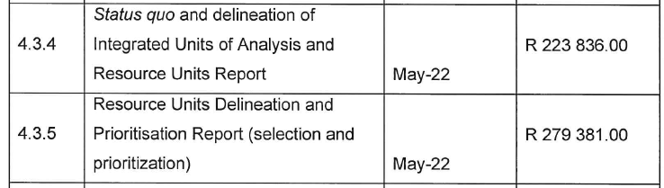
No Budgets/financial info in inception report, covered in contract
Critical role of DWS in delivery path: eg upcoming milestones
  Submit draft of milestones 4.3.4 & 4.3.5 in April
  Comments and PSC 1 presentation (PMC 2 drY run) required to finalise reports and invoice by due date, May 2022

